Slide 1
Lambda Introduction
With Python and Serverless Framework

Slide 2
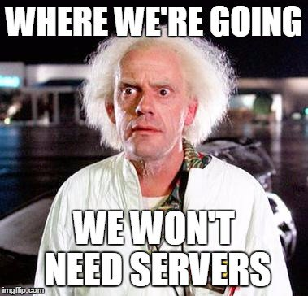

Slide 3
Getting Started
Do you have:
Anaconda Python (Google: anaconda python for mac, download 3.7 version)
NodeJS (we need npm)
Serverless (installed by npm)
awscli
aws-azure-login
Docker

Slide 4
Let’s Not Drink The Kool Aid Yet
Lambda is not blazing fast
Lambda does not make DevOps out of job
Lambda can be a very expensive solution
Lambda is good for things that run infrequently
Lambda is good for event driven programming with AWS integration
Just use common sense, Lambda is not a silver bullet for everything

Slide 5
Python Golden Rules
Indentation is everything, there’s no braces {}
Don’t mix spaces with tabs with indentation, use Python friendly editor (e.g. atom)
Use 4 spaces for indenting or 2
To name functions, you can use camelcase or use underscore; python people use underscore (except for class name)
Want to know more? Search PEP-8

Slide 6
Python Modules/Libraries
How to install modules?
pip install public-module1 public-module2
Or, you can create requirements.txt file:
requirements.txt: public-module1 public-module2==version pip install -r requirements.txt

Slide 7
Python Function
import os ← this is how you import modules/libs def my_function(arg1, arg2): print(arg1, arg2) os.exit(0) my_function(“foo”, “bar”)

Slide 8
Build Your Own Library
awesome_lib/ awesome_lib/__init__.py awesome_lib/class_one.py awesome_lib/func_one.py import awesome_lib.class_one.cls_name import awesome_lib.func_one.real_func
Make sure the library is inside the python path

Slide 9
Create Virtual Environment
Use Anaconda to seed python 3 (MacOS comes with python 2.7)
conda create -n mylambda python==3.7.6 source activate mylambda OR conda activate mylambda Create working virtual environment for lambda
cd project_dir python -m venv venv source venv/bin/activate
Now you have an isolated virtual environment with python 3

Slide 10
Beginning in Serverless Framework
brew install node (if you don’t have node)
npm install -g serverless (install serverless)
sls upgrade (if serverless is too old)
aws-azure-login (get sts credential, choose sandbox)
sls create -t aws-python3 -p simple-surname -n full-name
aws-azure-login (get sts credential)

Slide 11
Let’s Talk About serverless.yml
Look at the functions section, that’s where the event integration happens
You can also make your serverless.yml more fancy, like:
Use plugins (e.g. AWS Step Functions)
Centralise parameters across the serverless.yml
Provide arguments from sls command line and inject into serverless.yml
Integrate with Cloudformation to create stack and IAM when you deploy sls
Integrate with existing Cloudformation via Outputs
Refer to the serverless framework documentation for its full feature

Slide 12
Serverless.yml: The command centre
provider: stage: dev region: ap-southeast-2
Save serverless.yml, then deploy:
sls deploy
Invoke the function:
sls invoke -f hello -l sls invoke local -f hello -l

Slide 13
Let’s Modify the Python Code
Put this in your handler hello function (don’t forget the indentation):
print(“this is lambda by firstname.lastname”)
Deploy it
Invoke it locally (to run this, you don’t need to deploy)
Invoke it remotely
Check cloudwatch log (navigate from lambda monitoring console)

Slide 14
Let’s Talk About Getting Organised
cd project_dir mkdir -p functions/simpleprint mv handler.py functions/simpleprint/
# modify serverless.yml functions: hello: <- can be different from function name handler: functions/simpleprint/handler.hello
sls invoke local -f hello -l
FOR SIMPLICITY SAKE, OMIT THE simpleprint dir

Slide 15
Working with External Modules
Requirements.txt (at root of project dir): numpy
handler.py: import numpy
# look at the size of fullname.zip ls -lh .serverless/ sls package ls -lh .serverless/

Slide 16
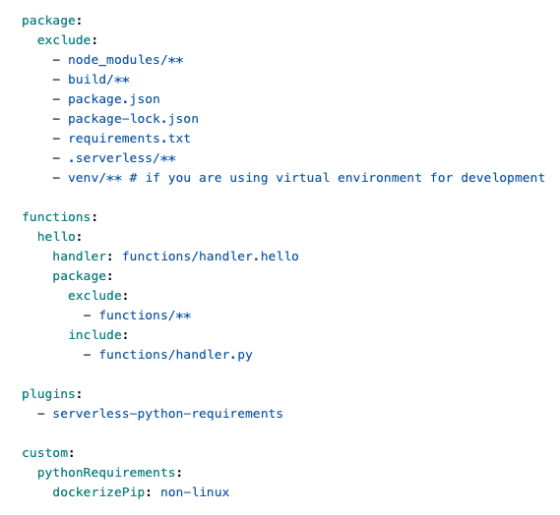
Automatic Packaging of External Modules
Package > exclude makes your zip file leaner from helper artifacts
Functions > exclude and include is a good practice to be specific with what you want to package with your lambda core function
Define serverless-python-requirements plugin and instruct to use docker

Slide 17
Let’s Test External Module Packaging
sls package # woops, it’s broken! npm init -f npm install --save serverless-python-requirements sls package ls -l .serverless/
To test code locally with external module dependencies:
pip install -r requirements.txt (within venv)

Slide 18
Push Your Fat Zip to the Cloud
Before deploying your code, take a look at your lambda function in AWS console, you can see your python code.
Deploy your fat lambda now
Take a look again at your code, can you see them?
Externalise your bulky modules with Layers.
You can re-use publicly available layers just by referring to its ARN from serverless.yml

Slide 19
Lambda Layers
Used for externalising big modules so your lambda can deploy faster
Checkout our BitBucket:
project: lambda-fargate-scalfolding
branch: using-layer
Before you leave, clean up: sls remove && shutdown -h

Slide 20
Summary
Don’t drink the Kool-Aid!
Learn Python, good language in general, excel in ML and sys admin
Use Python 3.7, not 2.7 unless you have no choice
Organise your lambda codes
Make your code lean, but if it’s fat by design, oh well
If there’s no built-in integration with Lambda, leverage Boto framework

